Slide 1
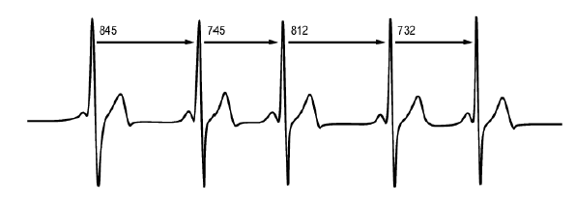
R-R Interval
https://support.polar.com/en/support/heart_rate_variability_hrv

Slide 2
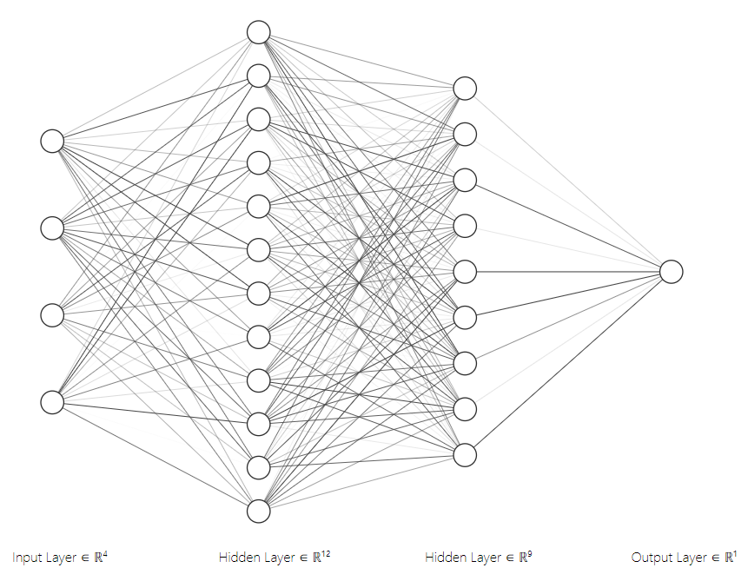
ANN Model Visualisation
VLF
LF
HF
LF/HF
Visualisation courtesy of: http://alexlenail.me/NN-SVG/index.html

Slide 3
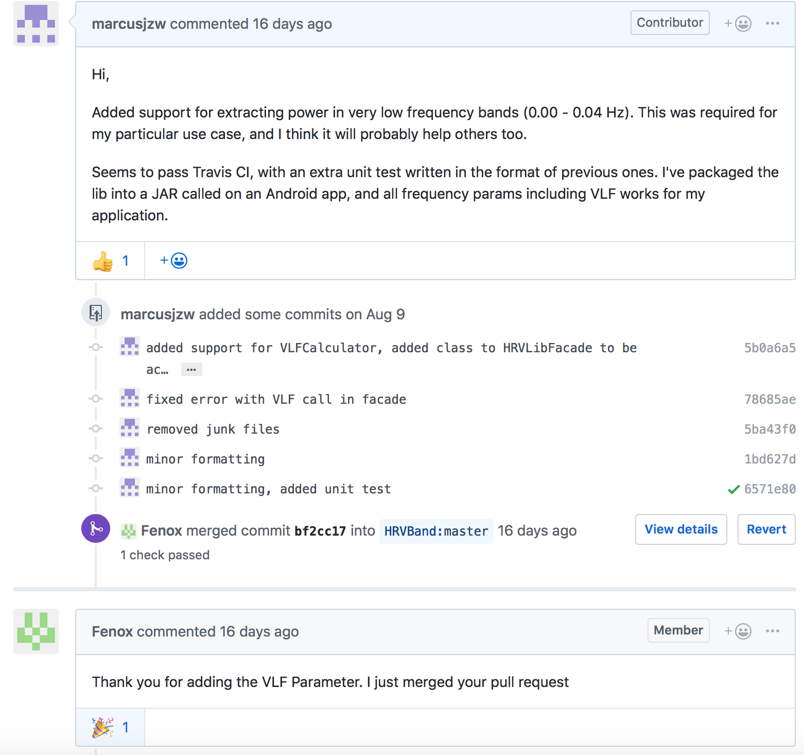
HRV-Lib: Open Source Pull Request

Slide 4
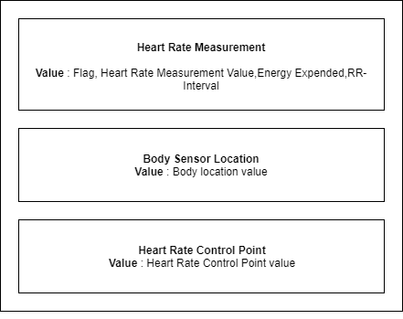
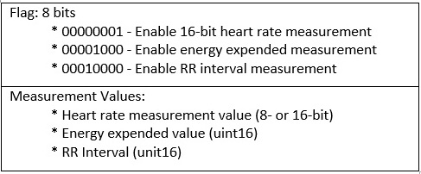
BLE: Heart Rate Service

